Slide 1
Chapter One
Introduction Of Microprocessor& Interfacing Devices
1

Slide 2
Outline
Introduction to Microprocessor
Evolutions of microprocessor
Microprocessor based Systems
Microprocessor Instruction Sets &
Various Computer Languages
2

Slide 3
Introduction
Microprocessor is the most important component of the digital computer.
  It acts as the brain of the computer.
It is a multipurpose, Programmable clock driven, register based electronic device,
That read binary instruction from a storage device called memory, accepts binary data as input and processes data according to those instructions and provides results as outputs.
Microprocessor is clock driven semiconductor device which for is manufactured by using LSI and VLSI technique
Microprocessor is a computer Central Processing Unit (CPU) on a single chip that contains millions of transistors connected by wires
Microprocessor is a programmable integrated device that has computing and decision-making capability, similar to CPU of a computer
Each μp has a fixed set of instructions in the form of binary patterns called machine language.
The binary instructions are given abbreviated names, called mnemonics, form the assembly language
3

Slide 4
Cntd…
A microprocessor is a controlling unit of a micro-computer, fabricated on a small chip capable of performing Arithmetic Logical Unit (ALU) and logical operation operations and communicating with the other devices connected to it.
Microprocessor consists of an ALU, register array, and a control unit.
ALU performs arithmetical and logical operations on the data received from the memory or an input device.
Register array consists of registers identified by letters like B, C, D, E, H, L and accumulator for microprocessor 8085 .
The control unit controls the flow of data and instructions within the computer.
4

Slide 5
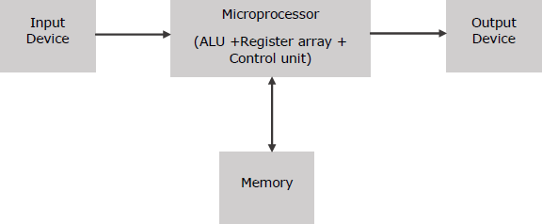
Cntd…
Block Diagram of a Basic Microcomputer
The Intel 8085 is an 8-bit microprocessor introduced by Intel in 1976.
It was binary-compatible with the more famous Intel 8080 but required less supporting hardware, thus allowing simpler and less expensive microcomputer systems to be built.
The "5" in the model number came from the fact that the 8085 requires only a +5-volt
(V) power supply rather than the +5V, −5V and +12V supplies the 8080 needed. ⁵

Slide 6
How does a Microprocessor Work?
The microprocessor follows a sequence:
  Fetch,
  Decode, and
  then Execute.
Initially, the instructions are stored in the memory in a sequential order.
The microprocessor fetches those instructions from the memory, then decodes it and executes those instructions till STOP instruction is reached.
Later, it sends the result in binary to the output port.
Between these processes, the register stores the temporarily data and ALU performs the computing functions.
6

Slide 7
Cntd…
Some of the frequently used terms in a microprocessor
Instruction Set: It is the set of instructions that the microprocessor can understand.
Bandwidth: It is the number of bits processed in a single instruction.
Clock Speed: It determines the number of operations per second the processor can perform.
It is expressed in megahertz (MHz) or gigahertz (GHz).It is also known as Clock Rate.
Word Length: depends upon the width of internal data bus, registers, ALU, etc.
An 8-bit microprocessor can process 8-bit data at a time.
  The word length ranges from 4 bits to 64 bits depending upon the type of the microcomputer.
Data Types: microprocessor has multiple data type formats like binary, BCD,
ASCII, signed and unsigned numbers.
7

Slide 8
Features of a Microprocessor
Some of the most prominent features of any microprocessor
Cost-effective: The microprocessor chips are available at low prices and results its low cost.
Size: The microprocessor is small size chip, hence it is portable.
Low Power Consumption: Microprocessors are manufactured by using metal oxide semiconductor technology, which has low power consumption.
Versatility: The microprocessors are versatile as we can use the same chip in a number of applications by configuring the software program.
Reliability: The failure rate of an IC in microprocessors is very low, hence it is reliable
8

Slide 9
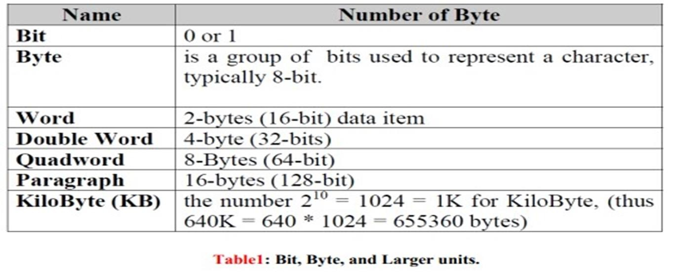
Types of Microprocessors
Microprocessors generally are categorized based on maximum number of bits in the data they process.
by their word length. Over time, five standard data widths have evolved for
microprocessors: 4-bit, 8-bit, 16-bit (word), 32-bit,64-bit.
9

Slide 10
Microprocessor Evolution
The first microprocessor was introduced in the year 1971 by Intel and was named Intel 4004.
Intel 4004 is a 4 bit microprocessor and it was not a powerful microprocessor.
It can perform addition and subtraction operation on 4 bits at a time.
In 1976, Intel introduced 8085 processors which is nothing but an update of 8080 processors.
8080 processors are updated by adding two Enable/Disable Instructions, Three added interrupt pins and serial I/O pins.
Intel introduced 8086 pins during the year 1978.
The major difference between 8085 and 8086 processor is that 8085 is an 8 bit
processor, but 8086 processor is a 16 bit processor
10

Slide 11
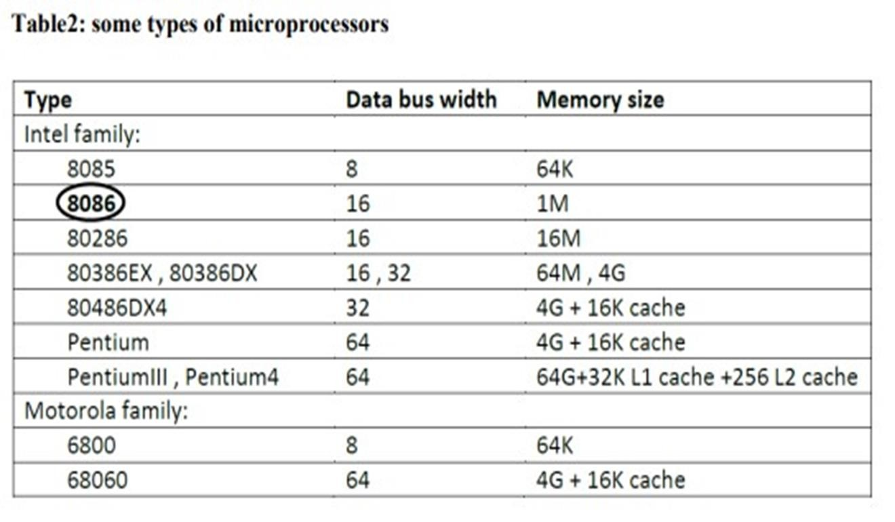
Manufacturers
Apart from Intel, there are some other manufacturers
  E.g., Motorola, AMD, Mitsubishi, NEC, OKI, Toshiba, Siemens etc.
From these manufacturers of Microprocessors, only two companies have been produces popular microprocessors: Intel and Motorola.

Slide 12
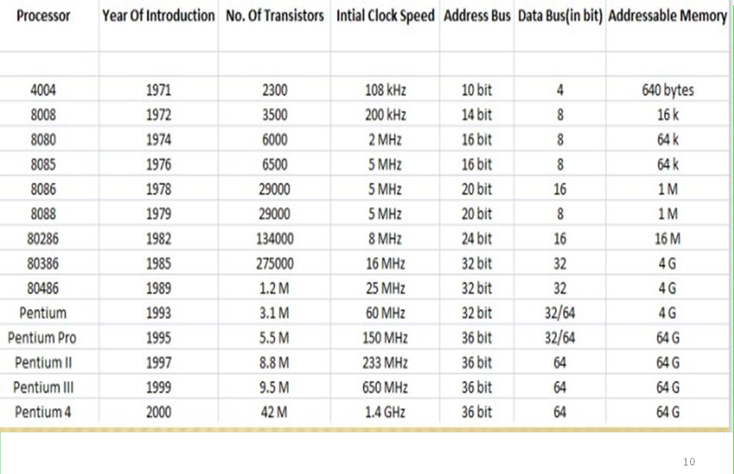
Brief History of CPU(Evaluation of Intel’s Microprocessors)

Slide 13
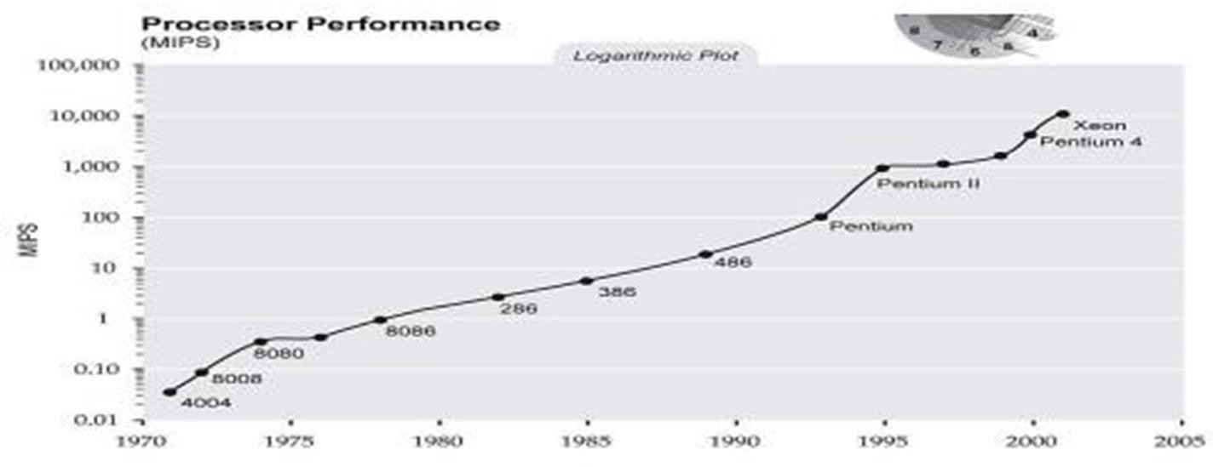
Cntd…
Performance of microprocessor is measured in what are called MIPS, that is how many million instructions they can execute per second.
They are measured by running a best program called the “drystone program”.

Slide 14
Architectural compatibility
Note that the 8086 has data bus width of 16-bit, and it is able to address 1Megabyte of memory.
It is important to note that 80286, 80386, 80486, and Pentium-Pentium4 microprocessors are upward compatible with the 8086 Architecture.
This mean that 8086/8088 code will run on the 80286, 80386, 80486,and
Pentium Processors,
but the reverse in not true if any of the new instructions are in use

Slide 15
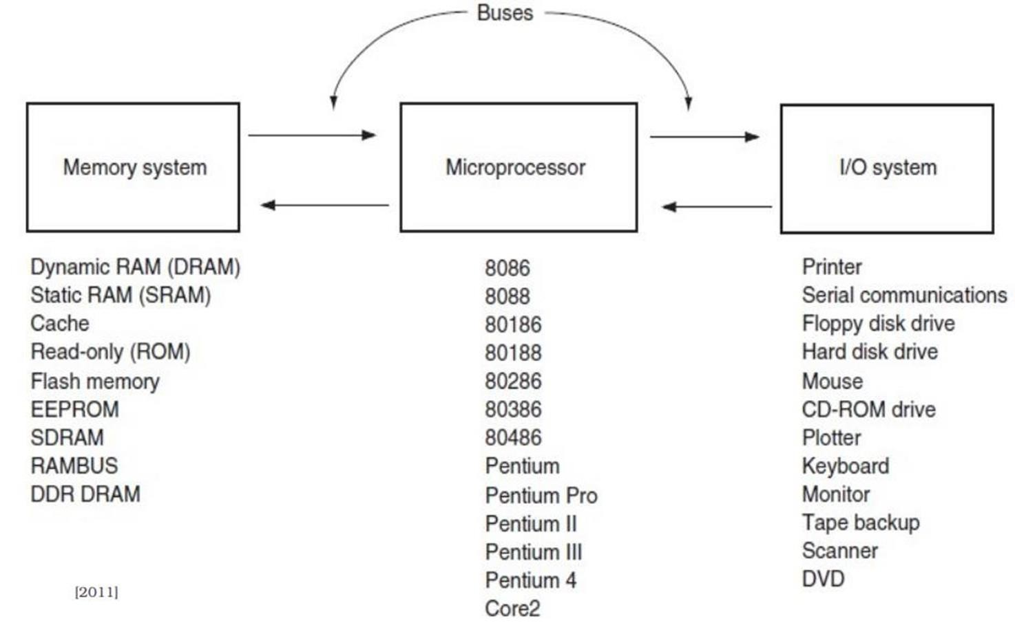
Organization of a microprocessor-based system

Slide 16
Cntd…
To perform a function, we have to form a system by using microprocessor as a CPU and interfacing memory, input and output devices to it.
A system designed using a microprocessor as its CPU is called a
microcomputer.
Microprocessor based system (single board microcomputer) consists of microprocessor as CPU, semiconductor memories like EPROM and RAM, input device, output device and interfacing devices.
The memories, input device, output device and interfacing devices are called peripherals.

Slide 17
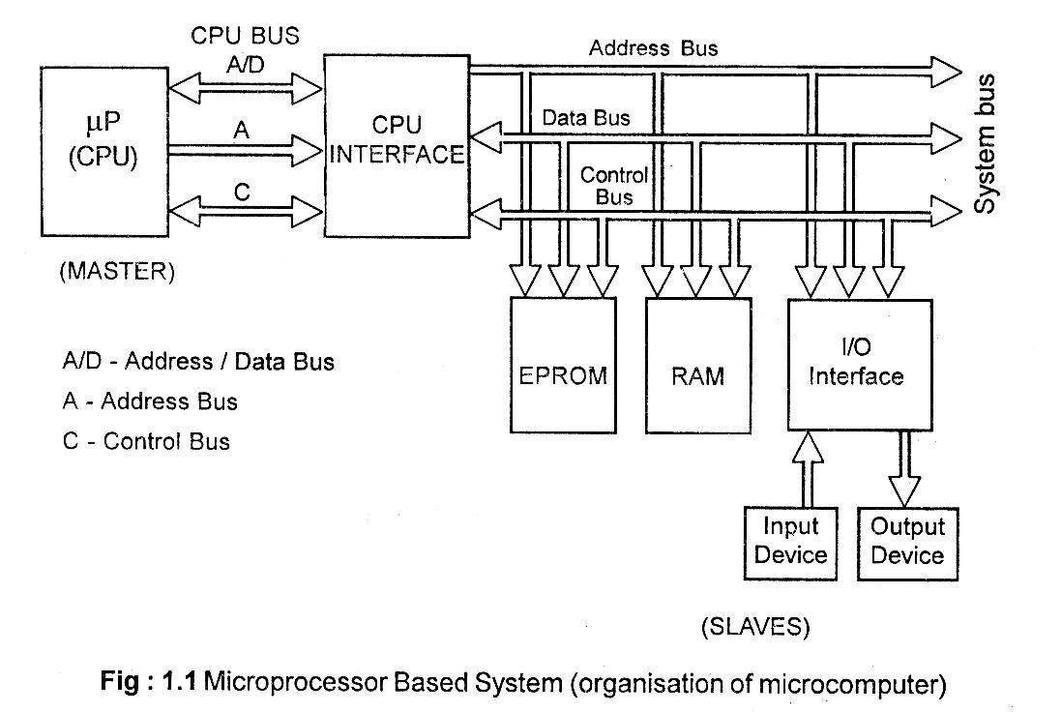
Cntd…

Slide 18
Cntd…
In the microprocessor (µP) based system, the microprocessor is the master and all other peripherals are slaves.
The master controls all the peripherals and initiates all operations.
The work done by the processor can be classified into the following three groups.
  (Internal Processor Operations):Work done internal to the processor
  (External Processor Operations):Work done external to the processor
  Operations initiated by the slaves or peripherals.
The work done internal to the processors are addition, subtraction, logical operations, data transfer operations, etc.
The work done external to the processor are reading/writing the memory and reading/writing
the J/O devices or the peripherals.
If the peripheral requires the attention of the master then it can interrupt the master and
initiate an operation.
18

Slide 19
Cntd…
System Bus
Wires connecting memory & I/O to microprocessor
  Address Bus: Unidirectional, Identifying peripheral or memory location
  Data Bus: Bidirectional, Transferring data
  Control Bus: Has Synchronization signals, Timing signals, and Control signals
The CPU Bus has multiplexed lines, i.e., same line is used to carry different signals.
The CPU interface is provided to demultiplex the multiplexed lines, to generate chip select signals and additional control signals.
The system bus has separate lines for each signal.
19

Slide 20
Cntd…
Advantages of Microprocessor based system
  Computational/processing speed is high.
  Since the devices are programmable, there is flexibility to alter the system by changing
the software alone.
  Less number of components, compact in size and less cost. Also it is more reliable.
  Operation and maintenance are easier.
Disadvantages of Microprocessor based System
  It has limitations on the size of data.
  The applications are limited by the physical address space.
  The analog signals cannot be processed directly and digitizing the analog signals introduces errors.
  Most of the microprocessors does not support floating point operations
20

Slide 21
Microprocessor Instruction Set And Computer Languages
Microprocessors recognize and operate in binary numbers.
However, each microprocessor has its own binary words, instructions, meanings,
and language.
The words are formed by combining a number of bits for a given machine.
The word (or word length), as defined earlier, is the number of bits the microprocessor recognizes and processes at a time.
The word length ranges from 4 bits for small, microprocessor-based computers, to 32 bits for such large computers as the IBM ES 9000 series.
Another term commonly used to express word length is byte.
1bit= 1 or 0
4 bits=1 nibble
2 nibble=1byte
8bits=1byte
21

Slide 22
Cntd…
Instruction is a complete task that the microprocessor can perform ; it can be made up of one or more words.
Each machine has its own set of instructions based on the design of its CPU or its microprocessor.
To be understandable to the microprocessor, instructions must be written in binary language, also known as machine language.
However, it is difficult for human beings to write programs in sets of 0s and 1s.
Therefore, microprocessor manufacturers have devised English-like words to represent the binary instructions of a machine, and programmers can write programs using these words. These are called assembly language programs.
Because an assembly language is specific to a given machine programs written in assembly language are not transferable from one machine to another.
To avoid this limitation, such general-purpose languages as BASIC, FORTRAN, PASCAL, and C , have been devised so that a program written in these languages can be machine-independent.
  These languages are called high-level languages (HLL).

Slide 23
Cntd…
In a microcomputer, the mnemonics are entered as ASCIl code using the keyboard as an input device, and the translation is performed by a program called an assembler.
The assembler is a program that translates the mnemonics entered by the ASCII keyboard
into the corresponding binary machine codes of the microprocessor.
Each microprocessor has its own assembler because the mnemonics and machine codes are specific to the microprocessor being used, and each assembler has certain rules that must be learned by the programmer.
Now the question is: How do words in English get converted into the binary languages of
different microprocessors?
The answer lies with another program called either a compiler or an interpreter. These programs accept English-like statements as their input, called the source code.

Slide 24
Cntd…
The compiler or interpreter then translates the source code into the machine language compatible with the microprocessor being used in the system.
This translation into the machine language is called the object code.
The compiler reads the entire program first and then generates the object code.
While the interpreter reads one instruction at a time, produces its object code, and ex- ecutes the instruction before reading the next instruction.
In Microprocessor architecture and interfacing with sufficient memory, high-level languages may be desirable for large programs, which saves debugging time
Despite of large memory usage requirements and slightly inefficiency execution

Slide 25
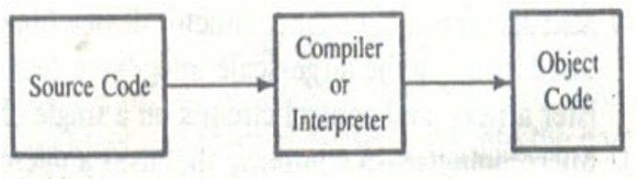
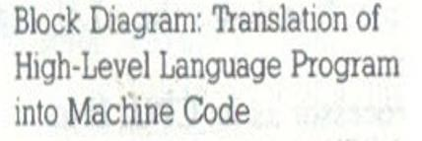
Cntd…
Block Diagram: Translation of High-Level Language Program into Machine Code

Slide 26
End of Chapter One
Any Question ???

